Slide 1
G4S Investigation Solutions
Insurance Irelands Fraud Conference
Compliant Surveillance and Insurance Investigation
7 April 2016
Martin Roach

Slide 2
Compliant Surveillance
Introduction
Martin Roach
Client Relationship Manager
The Cotswold Group part of the G4S Group

Slide 3
Agenda
Compliance
Intelligence led investigation
Surveillance as part of an investigation

Slide 4
Surveillance ‘an aid to investigation’
Understanding the Legislation
ECHR
Article 8 Human Rights Act
Covert Surveillance Bill 2008
Criminal Justice( Surveillance Bill ) 2009
The Privacy Bill 2006
Data Protection Act

Slide 5
Compliant Surveillance
UK Experience
ECHR
Regulation of Investigatory Powers Act 2000
Provided legislature frame work for ‘directed’ and ‘intrusive’ surveillance by Police, Intelligence, any other Public bodies
Investigatory Powers Tribunal

Slide 6
Compliant Surveillance
29 July 2010
Poole Borough Council suspected Mrs Paton of lying about living in a catchment area of a particular school, in order to obtain a place for her child - so they carried out surveillance without her knowledge.
The Council were tipped off by members of the public, one of whom said that Mrs Paton had boasted about fooling the Council, when in reality the family owned two flats in another location. The surveillance involved daily monitoring of movements for 3 weeks, the results being recorded on surveillance forms (no cameras or recording equipment was used).

Slide 7
Compliant Surveillance
Paton v Poole Borough Council
Paton complained to the Investigatory Powers Tribunal
The Council claimed that the surveillance was to detect criminal activity
The Tribunal found against the Council

Slide 8
Compliant Surveillance
Paton v Poole Borough Council
The Investigatory Powers Tribunal found that;
The Surveillance was not to detect crime
The Council had not explored other options in terms of investigation
The Surveillance could never be proportionate especially since young children were observed

Slide 9
Compliant Surveillance
Protection of Freedoms Act 2012 – changes to provisions under the Regulation of Investigatory Powers Act 2000 (RIPA)
Excessive use of Directed Surveillance

Slide 10
Data Protection Commissioner
Stated in Dec 2015
Surveillance must be:
Considered on a Case by case basis
Automatic Implication that a written specific policy detailing
1. Purpose
2. Justification
3. Procedures
4. Measures
5. Safeguards
Covert surveillance must be focused and of short duration. Only specific and relevant individuals should be recorded

Slide 11
Compliant Surveillance
Purpose
Justification
Client Responsibility
Procedures
Measures
Safeguards
Supplier Responsibility with Client agreement or oversight

Slide 12
Purpose and Justification
Objective and a test of proportionality
Have all other options been considered
Does the objective justify the method
McGowan v Scottish Water

Slide 13
Compliant Surveillance
Procedures
Front end Instruction screening and risk assessment
Claimant Profile and Open source research
Compliant and Supervised Surveillance
Deployment
Measures and Safeguards
DPA compliant transfer and retention of data
Agreed Surveillance Staff protocol supported by ongoing training and our Code of Practice
Independent and Central video editing facility having responsibility for the production of edited material.

Slide 14
_{Research}
Consumer Research
Residential Research
Commercial Research
Social Network Research and Analysis
General Internet Research
News Archive Research
Open Source Ethics:
Open Source data is by definition publically accessible
It is up to the individual how much personal information they make publically available
By placing it in the public domain, they are consenting to others viewing and interacting with it.

Slide 15
PROBLEM
Corroboration
Prospect Intelligence
Consented Data Search
Social Media Sites
Expenditure Profiling
Consumer Data
Forums and Community Sites
Non-Limited Company Searches
Tax Searches
Development
Directorship Searches
Validation
Credit Reference Agency Data
Domain/Website Searches
OPEN SOURCE RESEARCH
Property Searches
Classified Searches
IFIG Intelligence
Mapping
Cached Websites
ENTITY
INCIDENT
Dating Sites
CCJs
Historical Weather Searches
Personal Websites
News – Current / Historical
Insolvency Data
General Internet Searches
Property Sales Data
Relationship
Third Party Databases
Reserving
Government Sites
Property Rental Data
Shopping Sites
Image searches
Review Sites
Blog Searches
Trade Sites
Association
Investigation
LOCATION

Slide 16
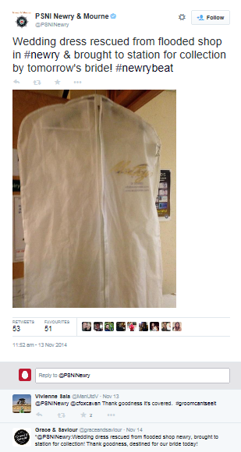
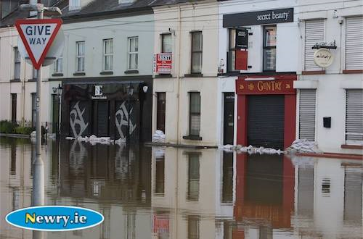
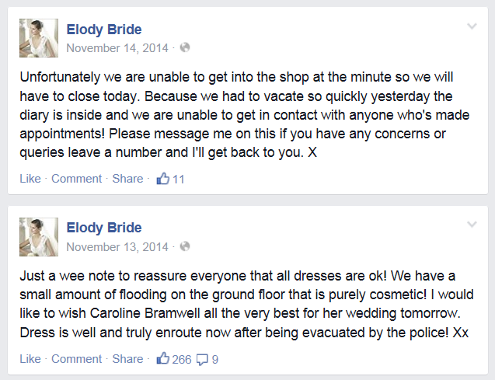
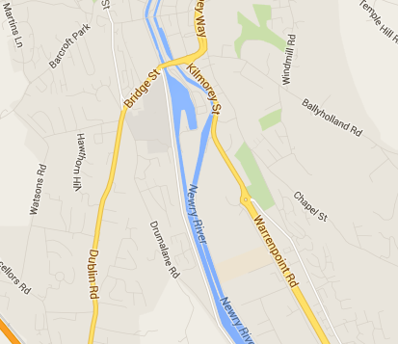
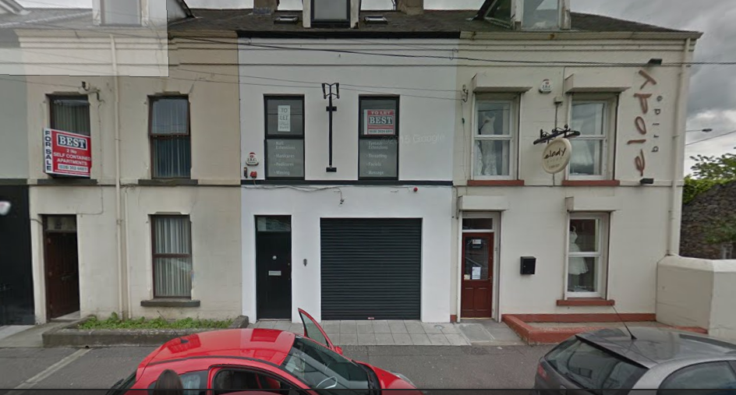
LOCATION – FLOOD INVESTIGATION
Circumstances:
At 15:00 hours on the 13th November 2014, Insured Party incepted a Policy to cover his business premises, a clothing company in Northern Ireland. The Policy has previously lapsed due to non payment of renewal.
At 14:00 the following day, the Insured Party, telephoned Insurers to make a claim for flooding. Stating that his stock to the value of £25,000 had been damaged.
Insurers passed the case to us for investigation through Open Sources

Slide 17
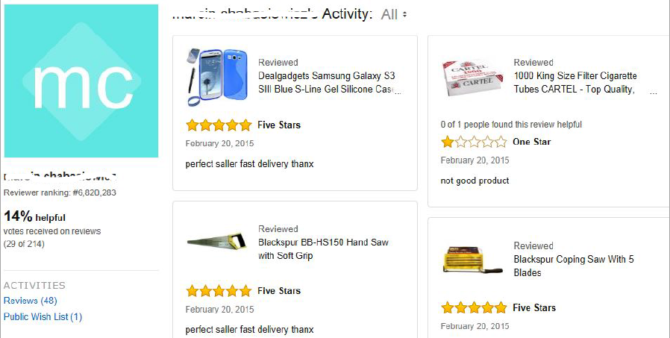
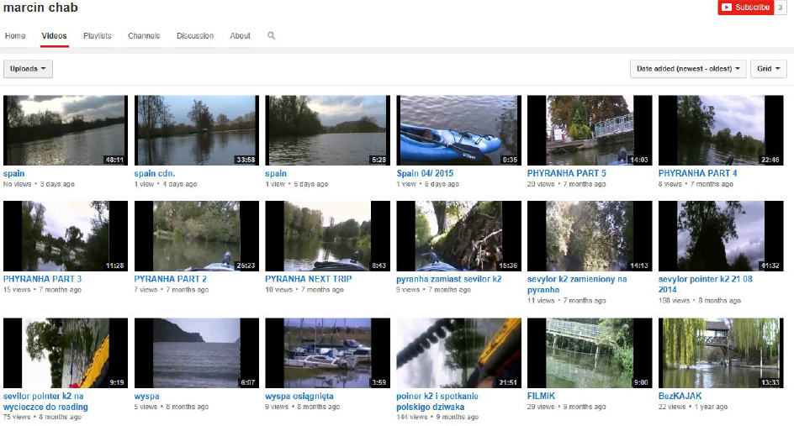
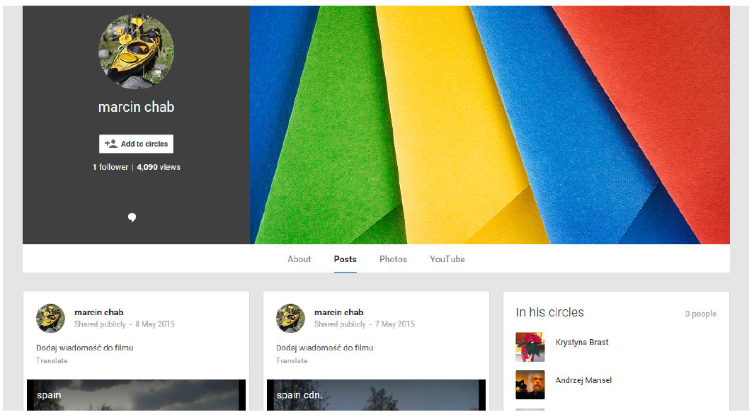
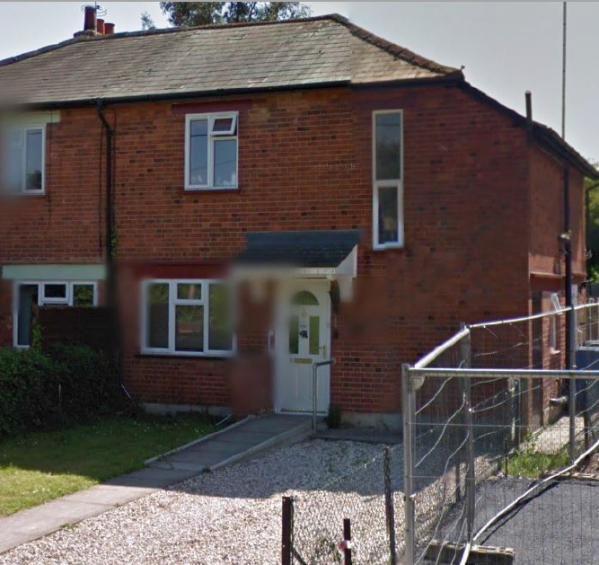
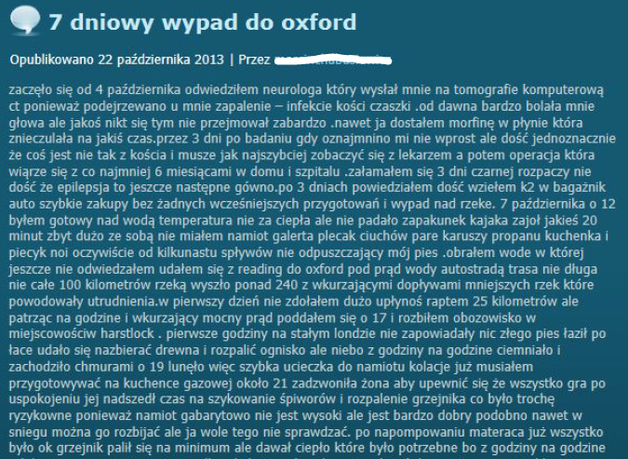
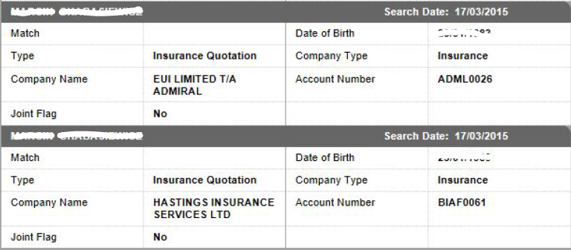
Summary
On the 4th October 2013, the Claimant visited a neurologist who sent him for a screening as they suspected inflammation and brittle bones in the skull.
The Claimant states that he was suffering from a number of headaches that were being treated with Morphine.
His epilepsy has been an ongoing problem, throughout the period and it is driving him to despair.
However - he has still managed to fit in some Kayaking, enjoying a paddle from Reading to Oxford, upstream. He had also enjoyed a kayaking holiday, travelling approximately 25 kilometres a day before camping on the banks of the river.
ENTITY – MAJOR LOSS CLAIMS INVESTIGATION
Circumstances:
On the 15th November 2013, the Claimant, a 32 year old Polish male, was struck by a ‘low loader’ whilst crossing the road. The Claimant reported that his injuries were so severe that he was now a Tetraplegic and had been suffering from Epilepsy that had come on since the incident.
A claim running into many thousands of pounds had been submitted – we were asked to investigate in April 2015.

Slide 18
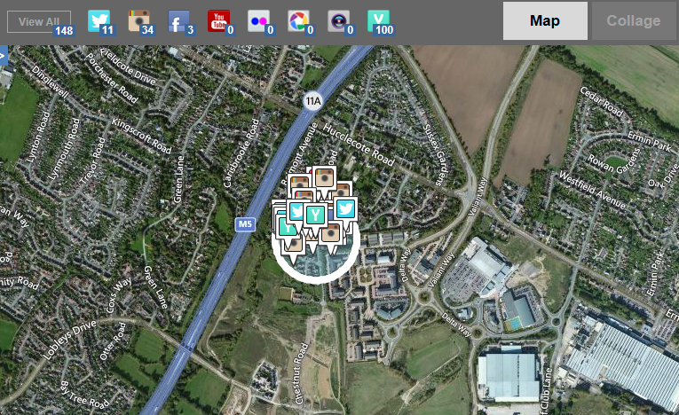
Location Based Social Media Analysis
Spatial Analysis:
It is now possible to identify a specific area (geo-fence) and identify all the Social Media geotagged to that location.

Slide 19
Location Based Social Media Analysis
Our social media analysis tool enables the harvesting of open source data from a specific location, supporting our intelligence findings and enabling us to conduct targeted research more efficiently.
How it works?
Our Analysts identify and highlight a specific location, in line with investigation objectives. A ‘Geo-Fence’ is created and all social media activity within the area is 'captured'.
Our Researchers then analyse the findings, develop them and prepare a complete report for the client.

Slide 20
Procedures
Privacy Impact assessment
Risk assessment
Allocation to Case Manager
Review of Intelligence and objective
Allocation to Area Manager
Allocation to Surveillance Team
Ongoing Supervision

Slide 21
The Surveillance Process
Instructions are managed via our case management system providing secure platform for data sharing and managing the investigation
Intelligence and research
Surveillance Operative completes observation with Case Manager support
Surveillance Operative reports back and new information is exploited
Footage is edited any sensitive data is pixelated
Case Manager reviews and completes report
Intelligence post Surveillance
Editing and Report
Surveillance
Instruction Received
Case Manager
Intelligence and information gathering
Intelligence during Surveillance

Slide 22
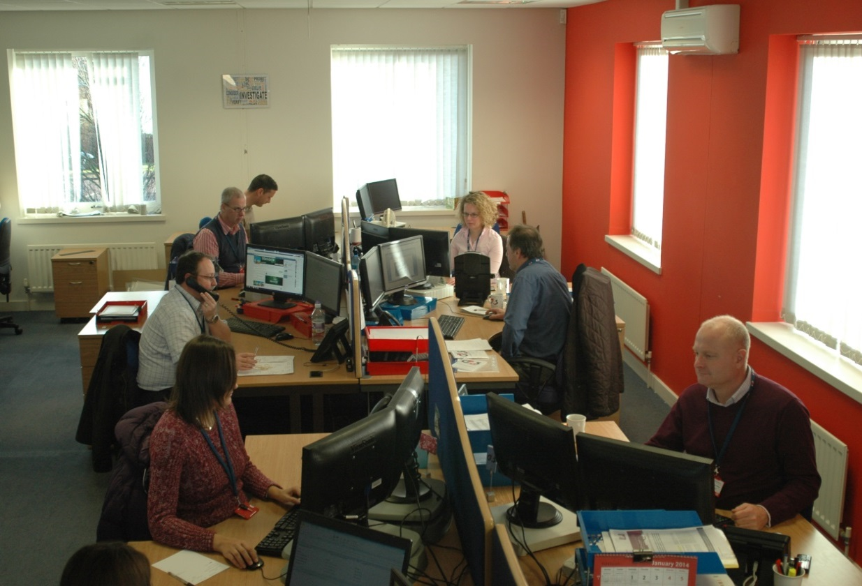
Pre-Surveillance
Check compliance and legality of instruction
Operational risk assessment
Investigation graded for operational complexity and strategic risk
Details checked against internal databases.
Case manager allocated
Information gathering
Reconnaissance and feasibility study
Bespoke strategy aimed at achieving the desired outcome developed jointly with file handler.
Secure communication of all relevant information to field teams
CASE MANAGEMENT TEAM

Slide 23
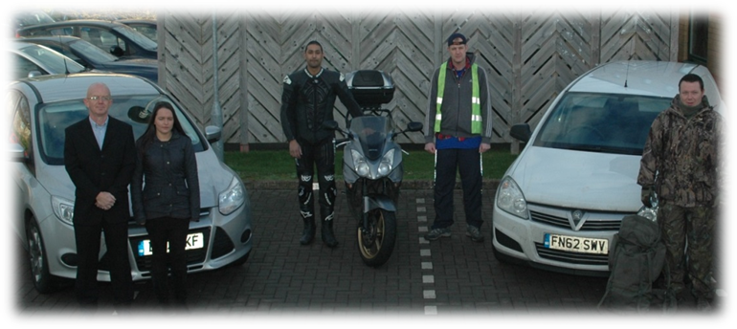
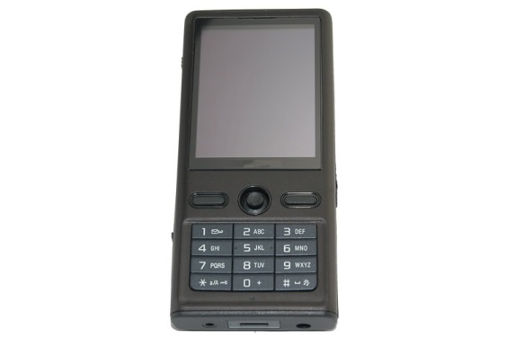
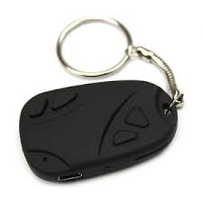
Surveillance Investigations
All Surveillance instructions are conducted in conjunction with all relevant legislation and regulation.
Surveillance techniques include mobile (vehicle) foot (pedestrian), and static (manned and unmanned).
Teams and tactics blended to suit the need of the investigation.
All equipment provided ensuring no cross contamination of data from other sources.
Information passed via secure e mail to provided hand held devices with remote access.

Slide 24
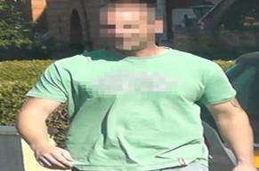
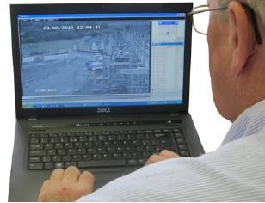
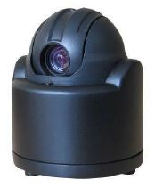
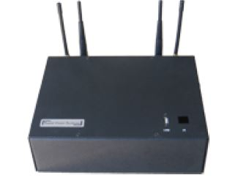
Technology
Identity protection
Market leading software enables efficient face blur.
All minors and footage of a sensitive nature identity protected as standard
Surveillance Portal
We have developed a secure online portal through which, clients can gain access to all footage obtained on their instructions as well as our final report and Operative Logs
Benefits include enhanced security and a more efficient service
Surveillance Equipment
Continual monitoring of the market to ensure our equipment is best available to meet the needs of clients

Slide 25
Data Handling and Security
We are subject to 6 monthly audits of our Quality and Information Security management systems to ensure continued adherence and accreditation with ISO 9001 and ISO 27001 standards.
Bespoke editing policy and Code of conduct.
Formal reporting process
Secure on site physical and electronic storage.
Dedicated team maintain audit trial and ensure continuity of evidence.
EDITING TEAM

Slide 26
Compliant Surveillance
‘Covert surveillance must be focused and of short duration. Only specific and relevant individuals should be recorded’

Slide 27
Compliant Surveillance
‘Focused and of short duration’
Agreed and targeted surveillance
Proportionate deployment of surveillance having regard for the objective of the operation.
Only specific and relevant individuals should be recorded
Obtain film of those relevant to the objective of the Operation and take steps to minimise the likelihood of collateral intrusion
No filming though windows into private home
No filming in sensitive areas e.g in the area of schools, public swimming baths.

Slide 28
Compliant Surveillance
What is a ‘result’?
Surveillance is a passive intelligence gathering activity
It can capture evidence to suggest fraudulent activity leading to savings to the Client and further legal sanction where appropriate.
It can also prove the Claim is genuine and ensure a more timely and therefore cost efficient settlement of the Claim in question.

Slide 29
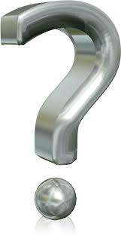
Questions and Next Steps

